Slide 1
CONVERSATIONAL IMAGE RECOGNITION CHATBOT
PIP2001 Capstone Project
Review- 1
Batch Number: CSE-07
Roll Number | Student Name
Under the Supervision of,
Mrs. Sreelatha P.K
Assistant Professor
School of Computer Science and Engineering
Presidency University
20211CSE0730 | PANKAJ SILOT
20211CSE0883 | DALJEET SINGH
20211CSE0718 | RODDICK VINCENT
20211CSE0728 | CHANDRASHEKHAR P
Name of the Program: CSE
Name of the HoD: Dr. Asif Mohammed H.B
Name of the Program Project Coordinator: Mr. Amarnath J.L & Dr. Jayanthi K
Name of the School Project Coordinators: Dr. Sampath A K / Dr. Abdul Khadar A / Mr. Md Ziaur Rahman

Slide 2
Content
Abstract
Literature Survey
Objectives
Existing Methods- Drawbacks
Modules
Hardware and Software Details
Timeline
References

Slide 3
ABSTRACT
A Conversational AI chatbot integrated with image recognition capabilities.
Uses NLP and deep learning to process images and respond intelligently.
Designed for BEL Organization to enhance automation and efficiency.
Aims to improve human-machine interaction through vision-based AI.
Potential applications in security, automation, and accessibility.

Slide 4
Literature Survey (10 Research Papers Summary)
Paper 1-3: Image recognition models like CNN, ResNet, YOLO for object detection.
Paper 4-6: NLP advancements (BERT, GPT, Transformer models) in chatbots.
Paper 7-8: Combining vision and language AI for improved interaction.
Paper 9: Real-time image processing and accuracy enhancement techniques
Paper 10: Challenges in integrating computer vision with conversational AI.

Slide 5
Objectives
Develop a smart chatbot that understands and recognizes images.
Improve accuracy using advanced AI models (CNN, NLP, Transformers, etc.).
Provide real-time responses based on image input.
Ensure a seamless user experience with natural conversation flow.
Deploy as a user-friendly application for BEL Organization.

Slide 6
Existing Methods
Traditional chatbots rely only on text-based NLP.
Image recognition models work independently without conversational AI.
Lack of real-time, interactive feedback in existing AI chatbots.
High computational requirements for deep learning applications.
Limited contextual understanding when combining vision and text.

Slide 7
Drawbacks of Existing Systems
No integration of image recognition with chatbots.
Poor context awareness when processing images.
Slow and high computational cost for deep learning models.
Limited learning ability in dynamic environments.
Inability to engage in meaningful conversations based on visual input.

Slide 8
Proposed Method
Use Spyder (Python IDE) for developing and debugging the AI model.
Implement CNN, YOLO, or Vision Transformers for object recognition.
Leverage NLP models (BERT, GPT, Transformer-based models) for conversations.
Process real-time image inputs and generate textual responses.
Integrate Flask/Django for deployment (if web-based).

Slide 9
Hardware and Software Requirements
Hardware:
High-performance GPU for AI model training.
Camera module (if real-time image input is needed).
Server or cloud storage for model deployment (if applicable).
Software:
Spyder IDE for Python development.
TensorFlow/PyTorch for AI model training.
NLTK, spaCy, Hugging Face for NLP processing.
Flask/Django for web-based implementation.

Slide 10
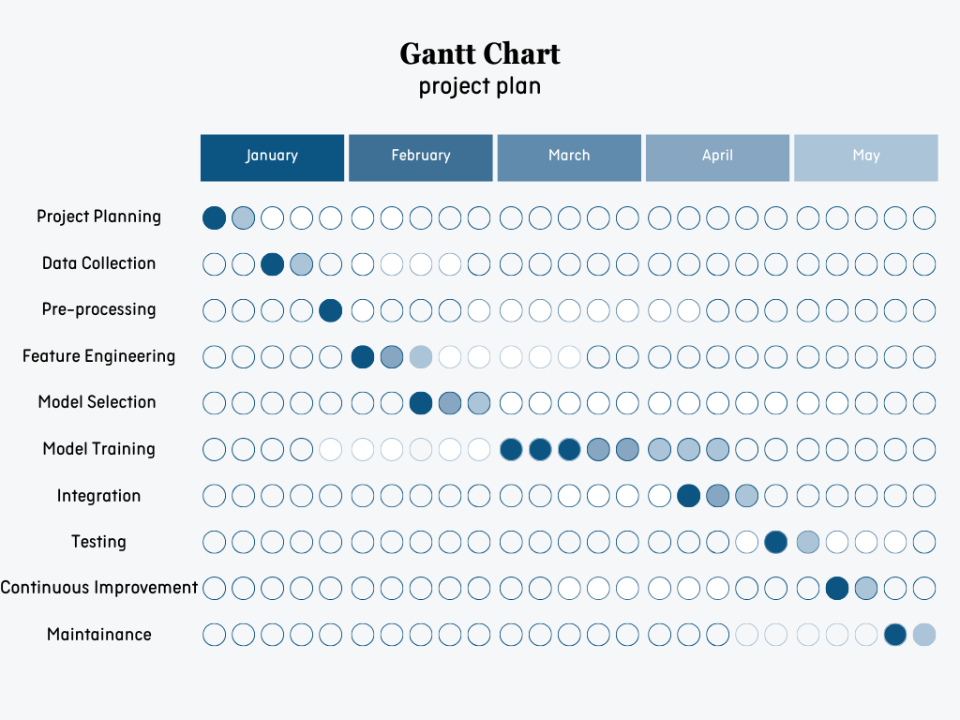
Timeline of the Project (Gantt Chart)

Slide 11
References (IEEE Paper format)
S. Liu, S. Wang, and Q. Zhang, "Deep Learning for Image Recognition: A Survey," Journal of Visual Communication and Image Representation, vol. 62, pp. 1031-1040, Dec. 2019. doi: 10.1016/j.jvcir.2019.02.017.
http://sciencedirect.com/science/article/abs/pii/S1047320319300690?via%3Dihub
M. D. Zeiler, and R. Fergus, "Visualizing and Understanding Convolutional Networks," Proc. European Conference on Computer Vision (ECCV), 2014, pp. 818-833. DOI: 10.1007/978-3-319-10590-1_53 https://link.springer.com/chapter/10.1007/978-3-319-10590-1_53

Slide 12


